Slide 1
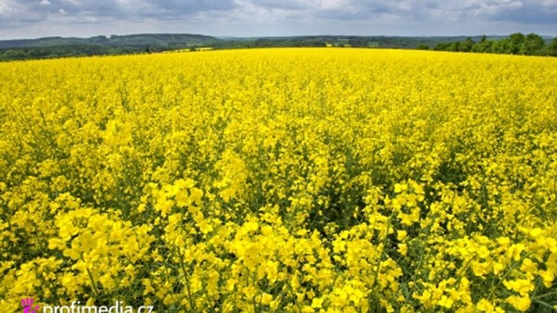
Biofuels – Are they a good solution for the future?
Patrick Reiter & Tereza Voborníková

Slide 2
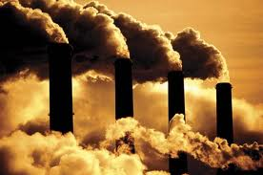
Why?
Lack of fossil fuels
Increasing human population on the earth
Environment

Slide 3
What are biofuels?
Physical condition classification (liquid, solid, gaseous)
Classification according to generation of biofuel (first, second)
Classification according to directive 2003/30/ES (Bioethanol, Biodiesel, Biogas, Bio-ETBE, Bio- METBE, Biohydrogen)

Slide 4
Austria
Biogas/Bioethanol in heating house systems
Biogas plant in Agrana
Biodiesel in transport
Main biodiesel production
Rapeseed and sunflower
Biodiesel Production capacity over 500.000 tons per year

Slide 5
Czech Republic
Use in transport
Main biodiesel made of rape seed
Great conditions
No ecological problems x „yellow avalanche“
3 main producers
No state support

Slide 6
Controversial points of view
Reduction of CO2
Cutting down rain forest
„Yellow avalanche“ in the Czech Republic
Independence
Improvement of countryside
„Food problem“

Slide 7
Conclusion
Lack of crude oil, increasing prices ☹
Biofuels are not a good solution but at least something
Necessary to develop something else

